Slide 1
How sustainable is my school?
Waste in our school

Slide 2
A few words about recycling
Recycling is the process of converting waste materials into new materials and objects. It is an alternative to "conventional" waste disposal that can save material and help lower greenhouse gas emissions (compared to plastic production, for example). Recycling can prevent the waste of potentially useful materials and reduce the consumption of fresh raw materials, thereby reducing: energy usage, air pollution (from incineration) and water pollution (from land filling).

Slide 3
Recycling in our school
In our school apply segregation of rubbish and waste. On every floors we have sets of trash cans. In every sets are 6 boxes:
For glass
For plastic
For paper
For metal
For other waste

Slide 4
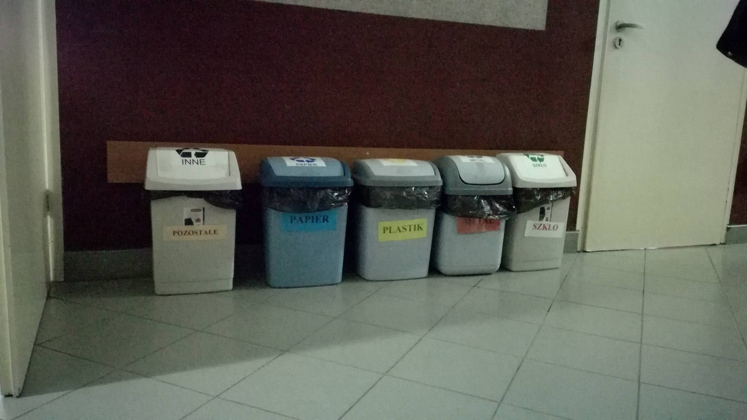

Slide 5
What we do with food residue?
Every day students in our school can use the canteen. Chefs work there every day and prepare dinner for our students. As you know after dinner is huge quantity of residue. What we do with this? We collect everything that we can to one container, take it home and give to our pets.
Notes:
http://blog-ekologiczny.blogspot.com/2010/12/jak-dziaa-segregacja-odpadow-i-jakie.html

Slide 6
Pro-ecological actions in our school
Our school is taking part in many pro-ecological actions. Our biology teachers are teaching us how important is to be ecological. We have many posters and things like that in our corridors to get our students know how important ecology is.
Notes:
http://blog-ekologiczny.blogspot.com/2010/12/jak-dziaa-segregacja-odpadow-i-jakie.html

Slide 7
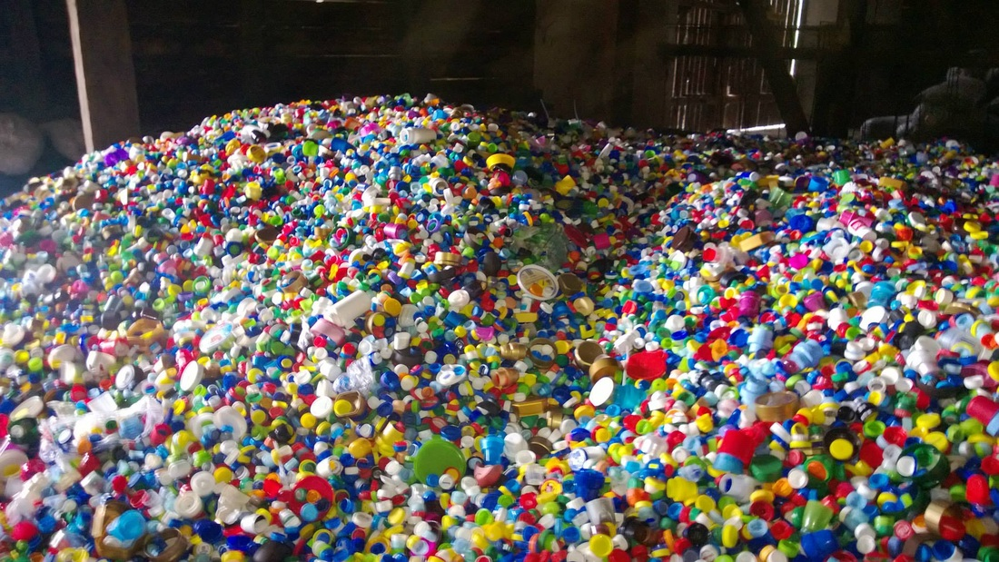
Collection of screw
In our school we lead collection of screw. That collection can help people, because kilogram of screw is worth about 0,17 Euro. Expect help by collection, collecting screw is friendly for environment. Packages without screw are easier for crushing and deal less place. It matters during transport and processing, because it lowers costs and shorten time of recyclable and processing materials.
Notes:
http://blog-ekologiczny.blogspot.com/2010/12/jak-dziaa-segregacja-odpadow-i-jakie.html

Slide 8
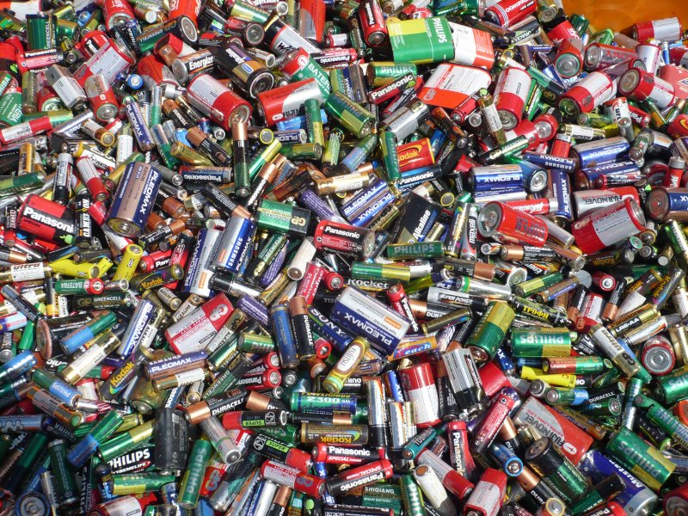
We collect used batteries
In our school for a long time we lead collection of used batteries.
That collecting have a lot of profits, primarily it protects us from secretion by batteries dangerous substances from roots and chemical compounds, which are components of batteries.
Notes:
http://blog-ekologiczny.blogspot.com/2010/12/jak-dziaa-segregacja-odpadow-i-jakie.html

Slide 9
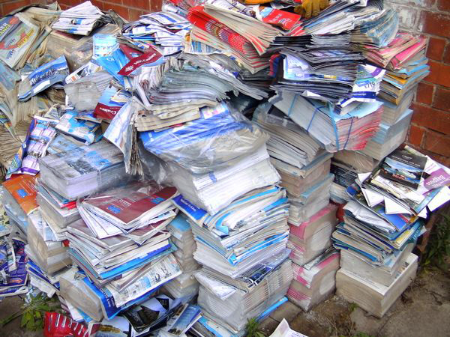
We collect waste paper
Paper is the main form of waste created by schools. We have also a lot of waste paper in our homes. There are a number of charity organisations which are collecting waste paper and buy important things for the people who need help by money that they earn on it. One of the famous organisations which is collecting waste paper, spend their money building wells in Sudan.
Notes:
http://blog-ekologiczny.blogspot.com/2010/12/jak-dziaa-segregacja-odpadow-i-jakie.html

Slide 10
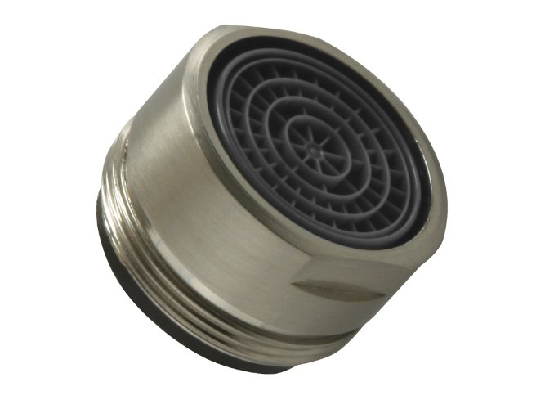
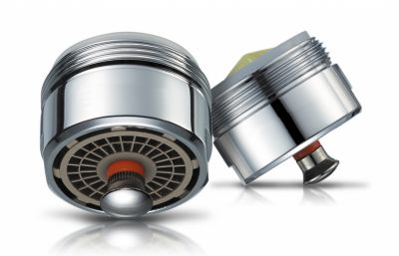
The newest eco-investment in our school
In the nearest time in every toilets in our school will listed aerators. Aerators are device that allows huge amounts of water. That thing is placed on the top of the battery and is very easy to use. Why do we do unnecessary costs if we can save a lot of water and money?
Notes:
http://www.ekologia.pl/wiedza/zanieczyszczenia/recykling-odzysk-surowcow-wtornych,11033,5.html

Slide 11
Summation
Summarizing, we think that our school is very friendly for environment. We can look after our planet and we are preparing her well for future generations. We think that we will lead more eco-campaigns, because expect that this is fashionable, this do a lot of well things for our health and life on the Earth.

Slide 12
You can decide
VS

Slide 13
Thanks for your attention Aleksandra Uchyra Julia Markowska from Poland

